Slide 1

The Social Media Trap
Analyzing the Impact of Social Media on Productivity

Slide 2
Objective
Identify Usage Patterns:
Analyze how humans allocate their time across various social media platforms.
Examine trends in usage based on age, gender, and other demographics.
Understand Behavioral Impact:
Explore the psychological and emotional effects of prolonged social media usage.
Investigate how social media habits influence productivity and personal relationships.
Highlight Key Distractions:
Identify specific activities or content types (e.g., videos, memes, trends) that lead to excessive
time consumption.
Assess Productivity Loss:
Measure the correlation between social media usage and reduced focus or efficiency in daily tasks.
Provide Insights for Better Usage:
Suggest strategies to minimize time wastage and promote mindful social media consumption.
Encourage a balance between online and offline interactions.

Slide 3
DATA SUMMARY
The “The Social Media trap” dataset offers a detailed look into user behaviour and engagement with social media platforms. It captures various attributes that can help analyse the impact of social media on users' time and productivity. This dataset is valuable for researchers, marketers, and social scientists aiming to understand the nuances of social media consumption.

Slide 4
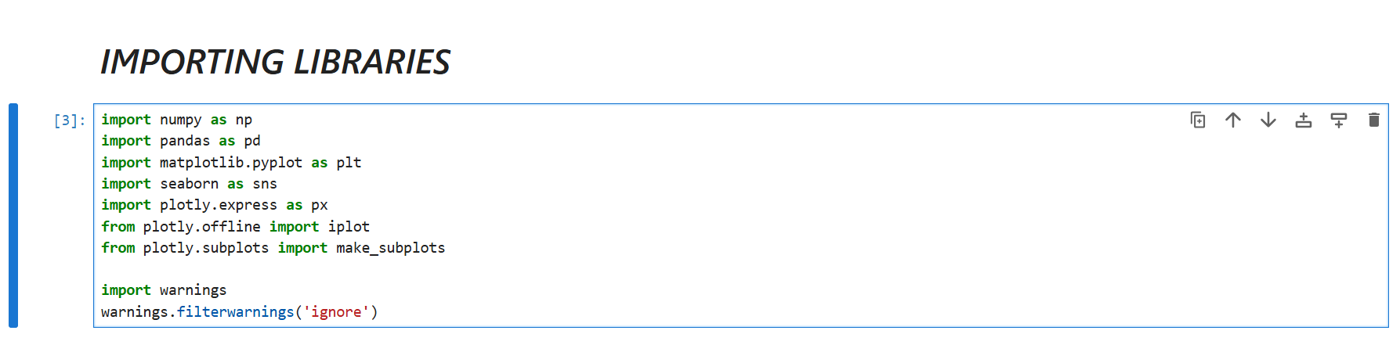
IMPORTING LIBRARY

Slide 5
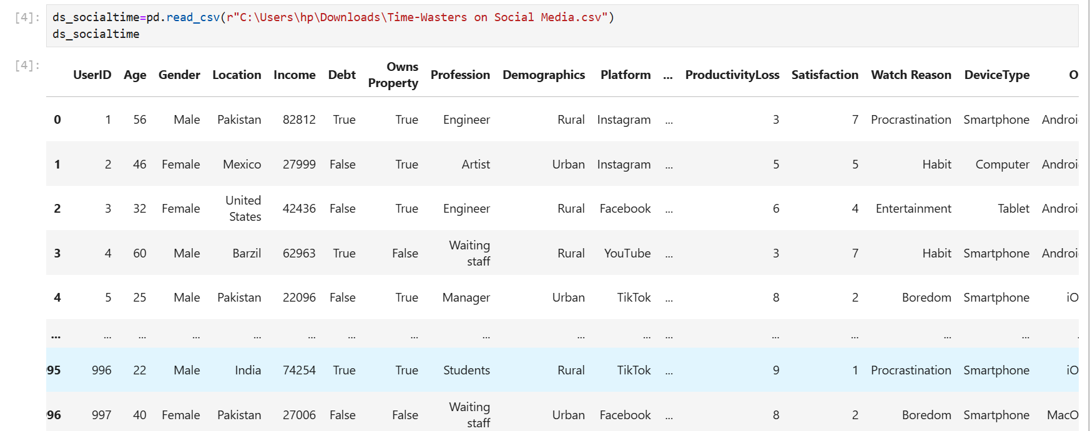
REading dataset

Slide 6
Columns Description –
UserID: Unique identifier assigned to each user.
Age: The user's age.
Gender: The user's gender (e.g., male, female, non-binary).
Location: Geographic location of the user.
Income: The user's income level.
Debt: Amount of debt the user has.
Owns Property: Indicates whether the user owns property.
Profession: The user's occupation or job.
Demographics: Statistical data about the user (e.g., age, gender, income).
Platform: The platform the user is using (e.g., website, mobile app).
Total Time Spent: The total time the user spends on the platform.
Number of Sessions: The number of times the user has logged into the platform.
Video ID: Unique identifier for a video.
Video Category: The category or genre of the video.
Video Length: Duration of the video.

Slide 7
Engagement: User interaction with the video (e.g., likes, comments, shares).
Importance Score: A score indicating how important the video is to the user.
Time Spent On Video: The amount of time the user spends watching a video.
Number of Videos Watched: The total number of videos watched by the user.
Scroll Rate: The rate at which the user scrolls through content.
Frequency: How often the user engages with the platform.
Productivity Loss: The impact of platform usage on the user's productivity.
Satisfaction: The user's satisfaction level with the platform or content.
Watch Reason: The reason why the user is watching a video (e.g., entertainment, education).
Device Type: The type of device the user is using (e.g., smartphone, tablet, desktop).
OS: The operating system of the user's device (e.g., iOS, Android, Windows).
Watch Time: The time of day when the user watches videos.
Self Control: The user's ability to control their usage of the platform.
Addiction Level: The user's level of dependency on the platform
Current Activity: What the user is doing while watching the video.
Connection Type: The type of internet connection the user has (e.g., Wi-Fi, cellular)

Slide 8
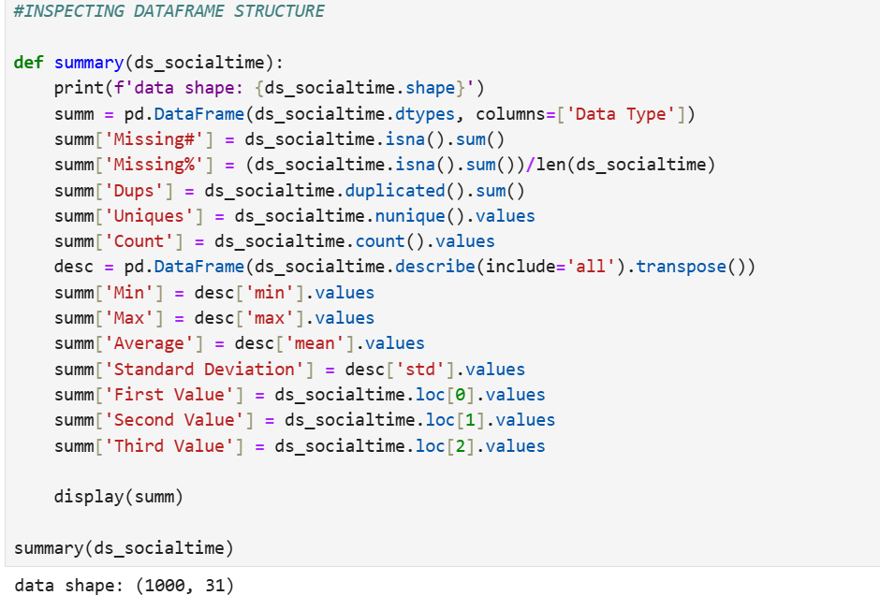
INSPECTING AND CLEANING DATAFRAME STRUCTURE

Slide 9
EXPLORATORY DATA ANALYSIS (EDA)
Preview the Data : Used functions like .head(), .tail() to view the data set.
Data Types : Used .info() to identify data types (numeric, categorical, etc.
Statistics: Used .describe() for statistical summaries like mean, median, min, and max for numerical columns.
Detect Missing Values : Used .isnull().sum() to check for missing values in columns.
Treat Missing Values: Impute or drop missing values, depending on the context.
Analysis : Applied Univariant , Bivariant , Multivariant analysis.

Slide 10
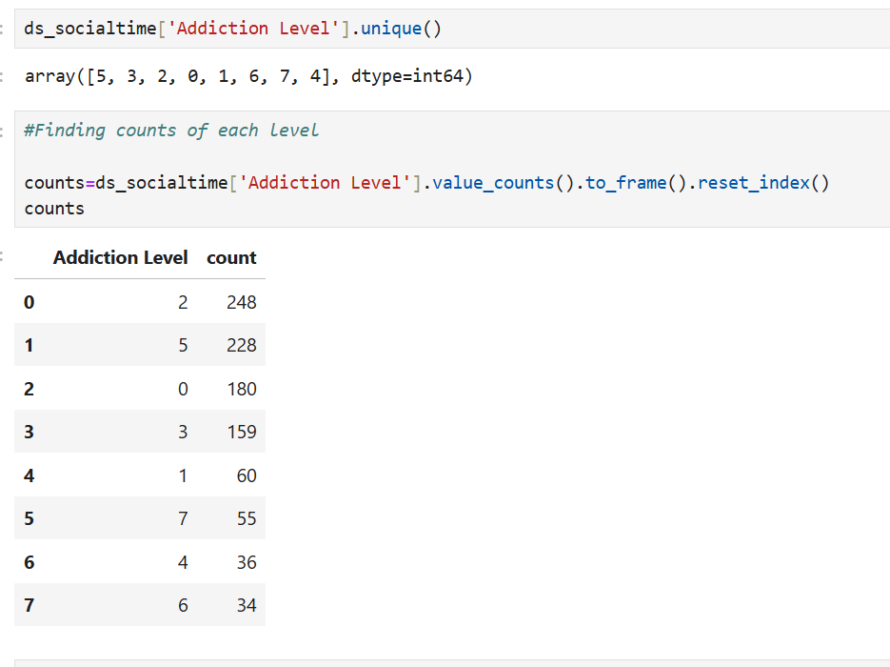
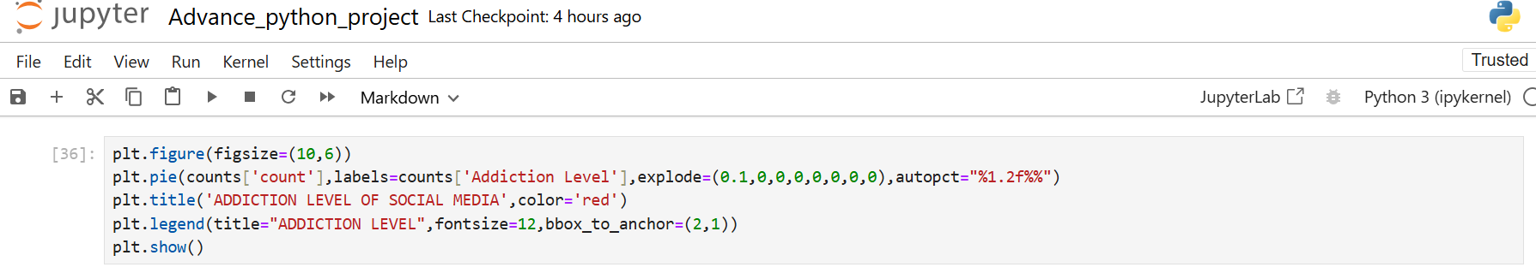
Q1 . ANALYSING ADDICTION LEVEL

Slide 11
The Addiction Level from 0 to 7 in your dataset represents the intensity of social media usage, where higher numbers indicate greater engagement or dependency.
*Level 0: No or very little use of social media.
*Level 1: Very low use or dependence.
*Level 2: Mild use, but not excessive.
*Level 3: Moderate use, part of the daily routine.
*Level 4: Significant use, affecting time management.
*Level 5: High use, impacting other areas of life.
*Level 6: Very high use, possibly neglecting responsibilities.
*Level 7: Extreme use, with a strong negative impact.
The higher the level, the more time or dependency on social media

Slide 12
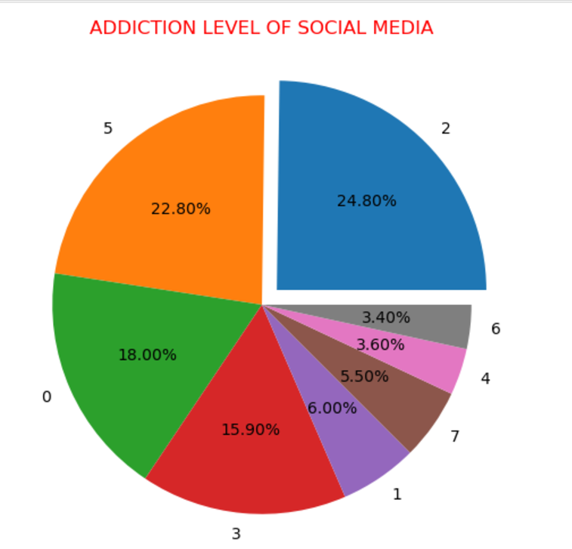
Insights
*Most Common Addiction Level :-
Addiction Level 2 is the most common,
with 248 users. This suggests that a
significant number of users are
moderately addicted to the platform.
*Low Addiction Level :-
Addiction level 6 has a lower count
of 34 (3.40%) , indicating a less
frequent addiction level in the dataset.
*High Addiction Levels are Rare :-
Levels 5 to 7 have fewer users
(55, 36, and 34, respectively),
showing that extremely high
addiction levels are less prevalent

Slide 13
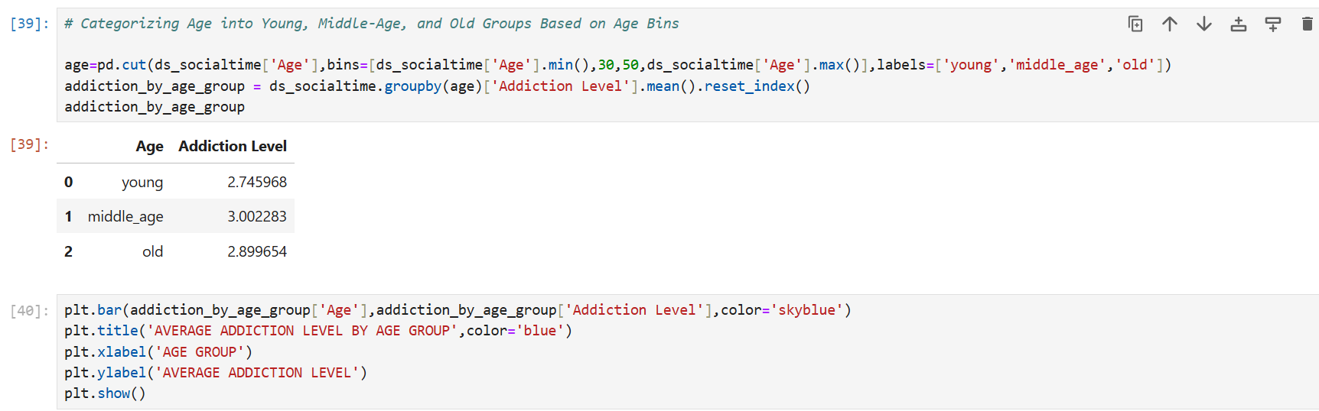
Q2. ANALYSIS OF ADDICTION LEVELS ACROSS AGE CATEGORIES

Slide 14
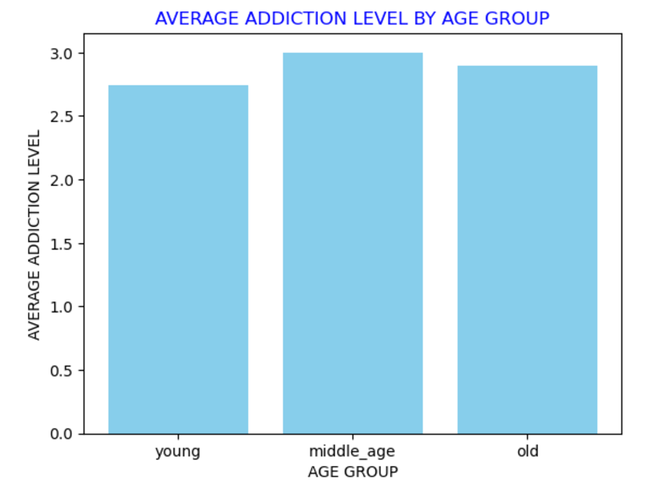
The middle_age group has the highest average addiction level at 3.00, compared to the young group at 2.75 and the old group at 2.90.
Insights

Slide 15
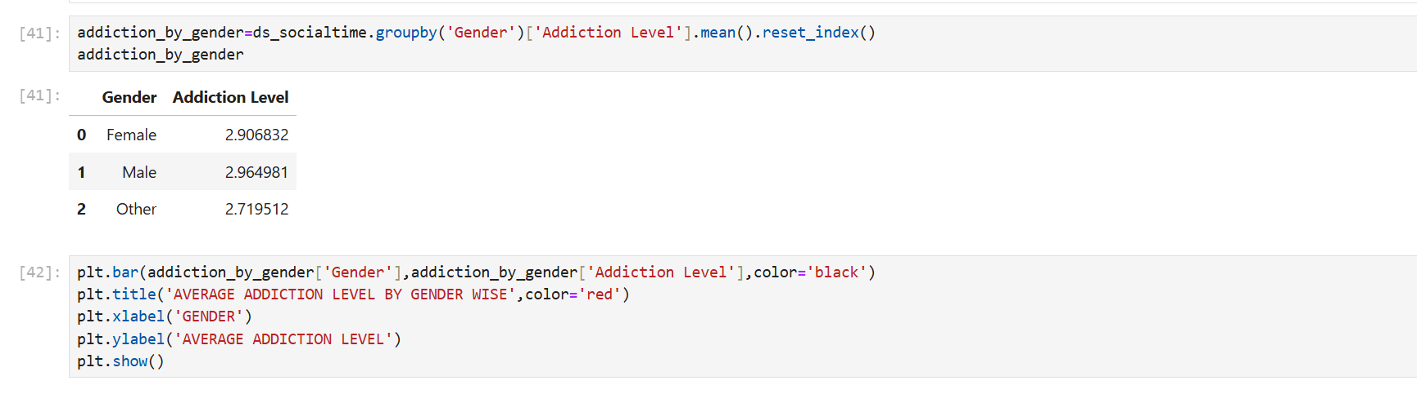
Q3. ANALYSIS OF ADDICTION LEVEL BY GENDER WISE

Slide 16
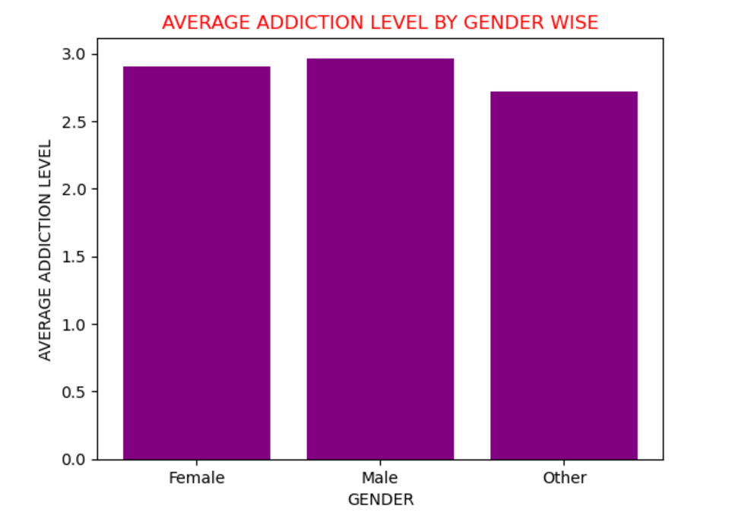
*Male Group Has the Highest Addiction Level: The Male group has the highest addiction level with a value of 2.965, indicating that males tend to have a higher addiction level compared to other genders. *The differences in addiction levels across genders are relatively small, with values ranging from 2.720 to 2.965
Insights

Slide 17
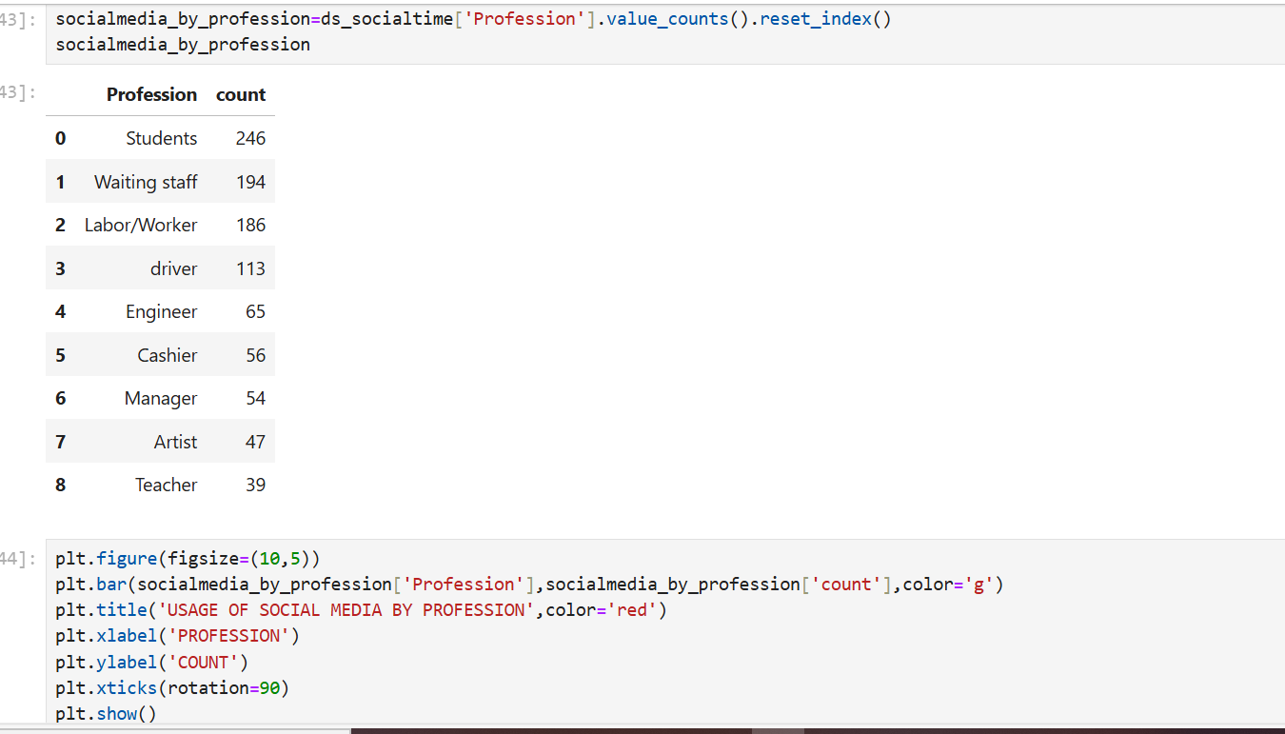
Q4. USAGE OF SOCIAL MEDIA BY PROFESSION (ANALYSIS OF PROFESSION DISTRIBUTION)

Slide 18
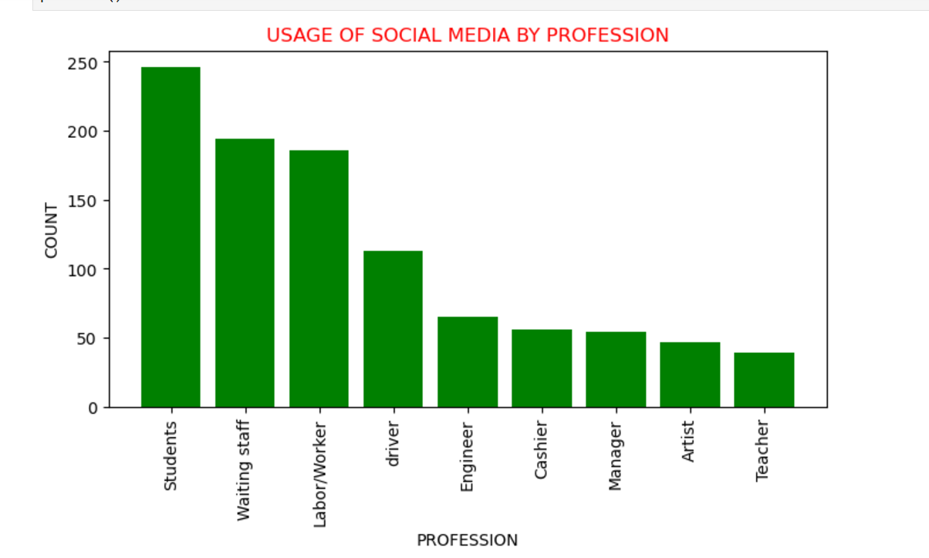
*The dataset is largely dominated by students and service industry roles (waiting staff, laboUr/workers). *while skilled professions such as engineers, managers, and teachers have smaller representations. *Creative professions (artists) are also present but in lower numbers
Insights

Slide 19
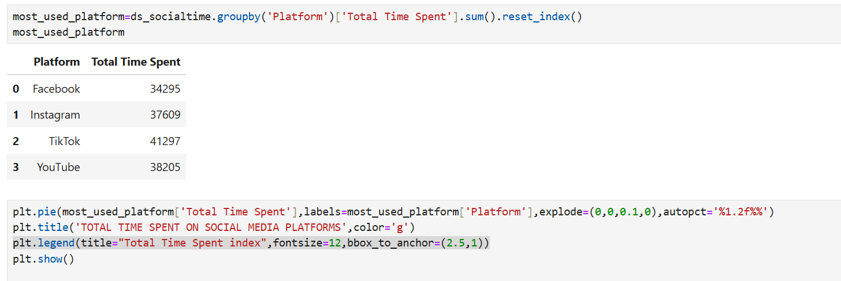
Q5. ANALYSIS OF TOTAL TIME SPEND ON SOCIAL MEDIA PLATFORMS

Slide 20
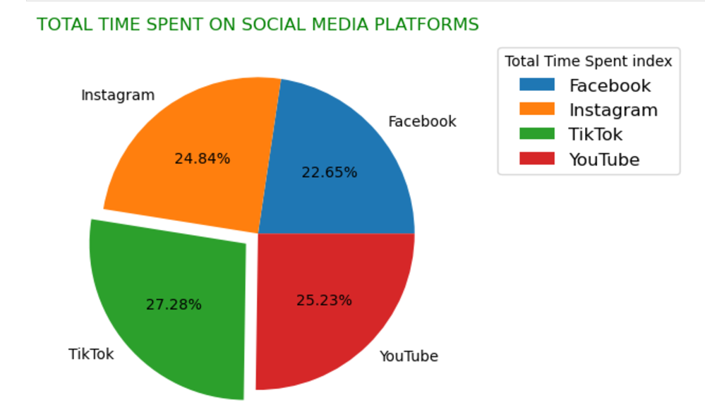
*It looks like TikTok is the most popular platform, followed closely by YouTube and Instagram. *Facebook is slightly behind but still has a significant share
Insights-

Slide 21
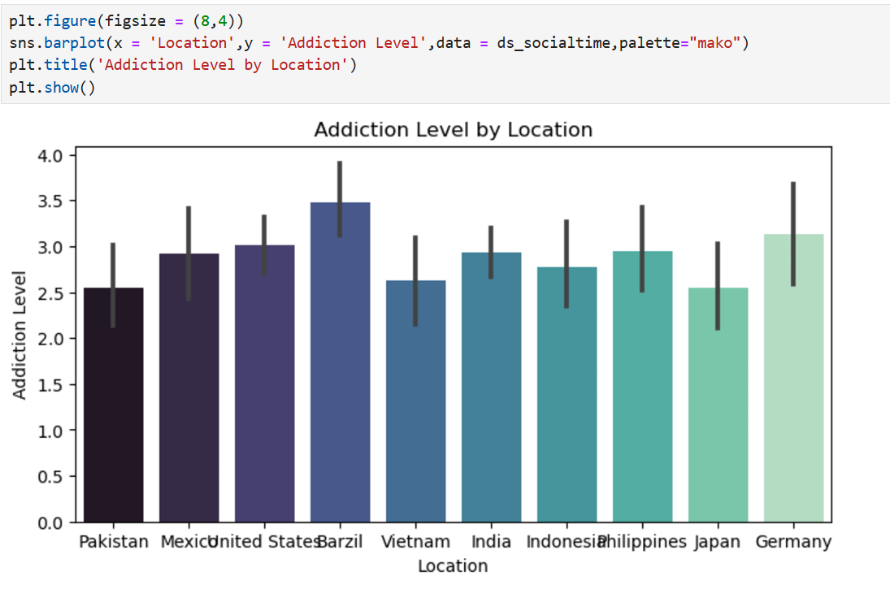
Q6. ANALYSIS OF ADDICTION LEVEL BY LOCATION
*Brazil and Germany show relatively higher addiction levels compared to other countries.
*Asian countries like Pakistan, Vietnam, and Japan tend to have lower addiction levels on average
Insights

Slide 22
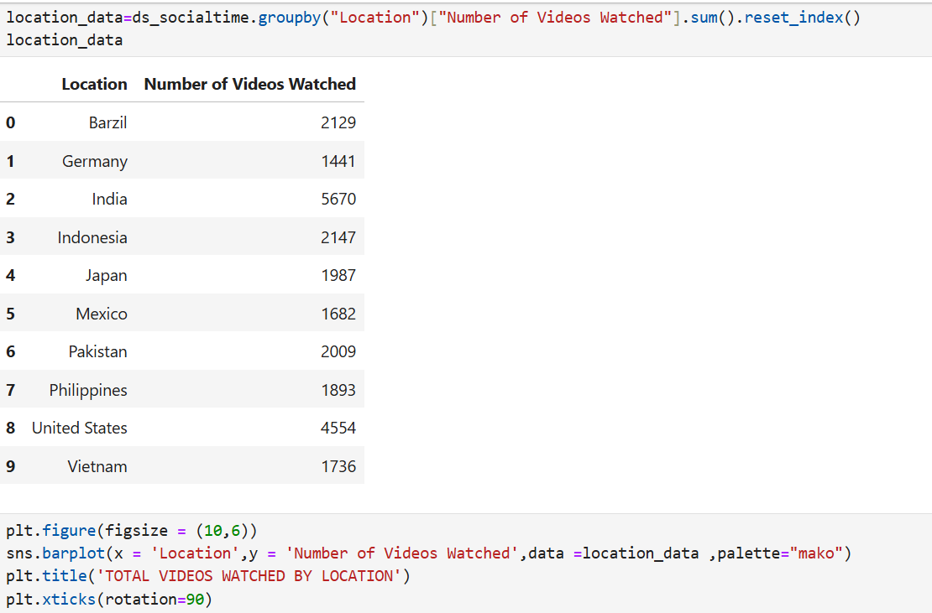
Q7. ANALYSING TOTAL NO OF VIDEOS WATCHED BY LOCATION

Slide 23
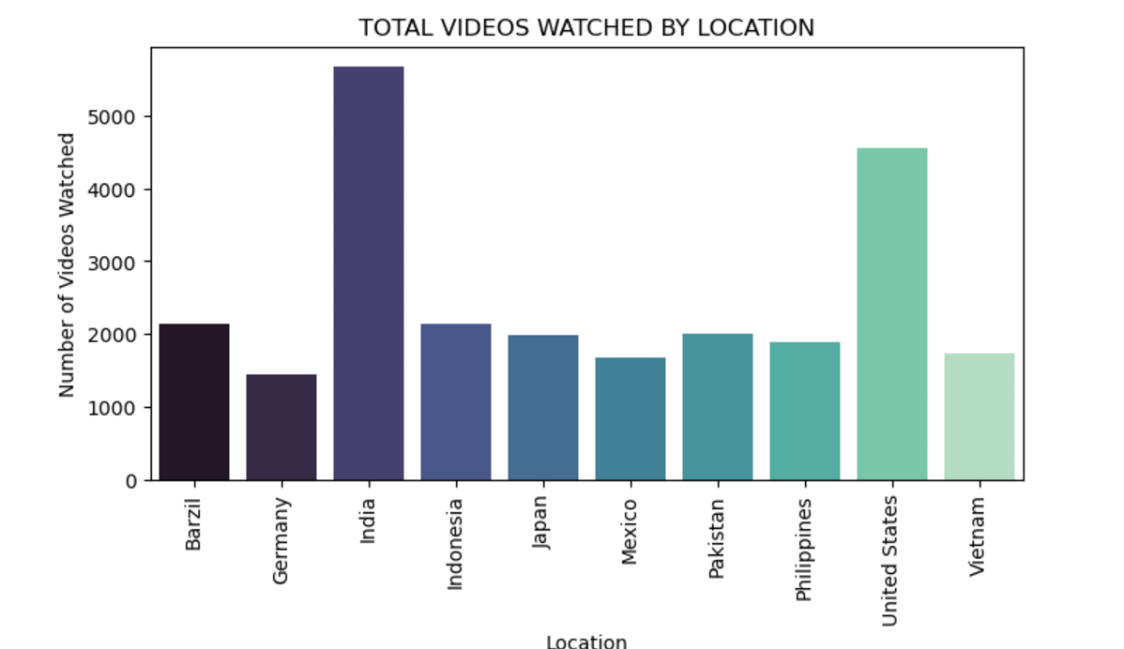
*India has the highest number of videos watched. *Germany has the lowest number of videos watched.
Insights-

Slide 24
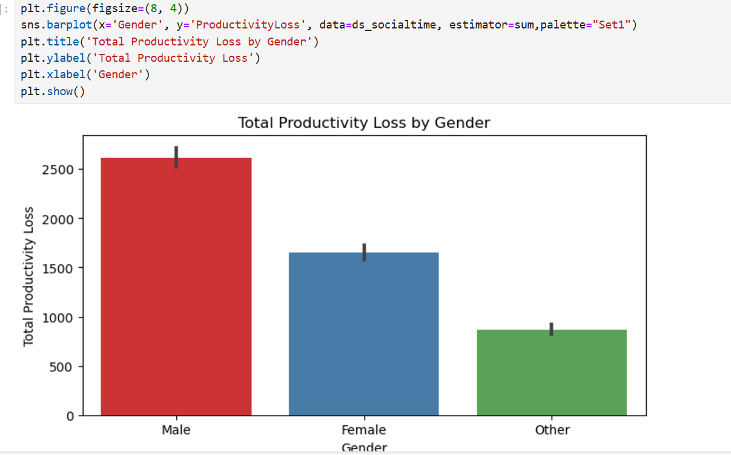
Q8. ANALYSIS OF PRODUCTIVITY LOSS BY GENDER WISE
*Highest Productivity Loss: The ‘Male’ category shows the highest total productivity loss, reaching close to 2500 units.
*Moderate Productivity Loss: The ‘Female’ category has a moderate productivity loss, with the bar indicating a value between 1500 and 2000 units.
*Lowest Productivity Loss: The ‘Other’ category has the lowest productivity loss
Insights

Slide 25
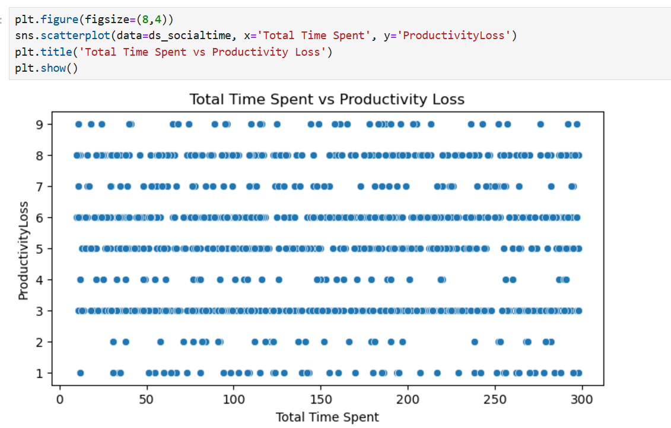
Q9. Relationship between Total Time Spent and Productivity Loss

Slide 26
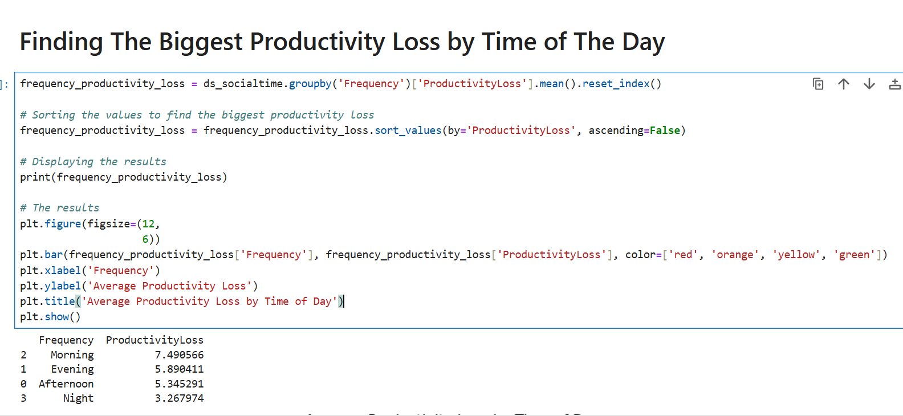
Q10. Finding The Biggest Productivity Loss by Time of The Day

Slide 27
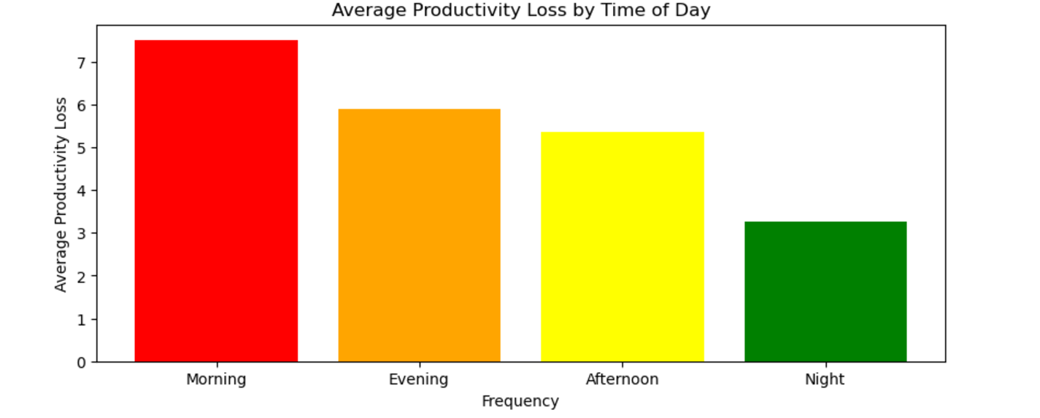
*Maximum in the morning and least in night

Slide 28
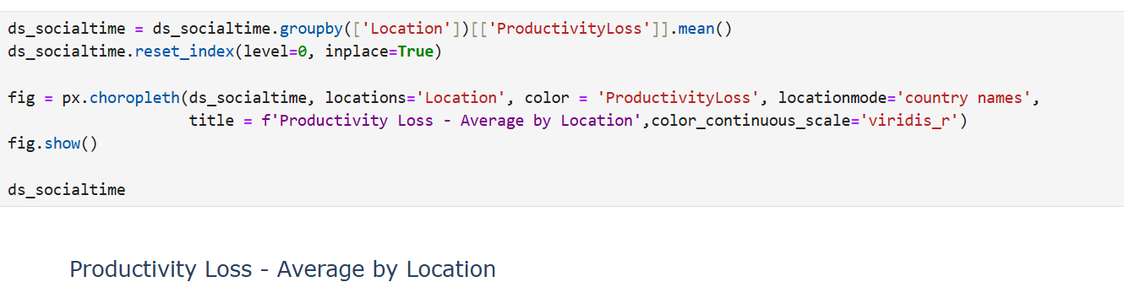
Q11. PRODUCTIVITY LOSS BY LOCATION

Slide 29
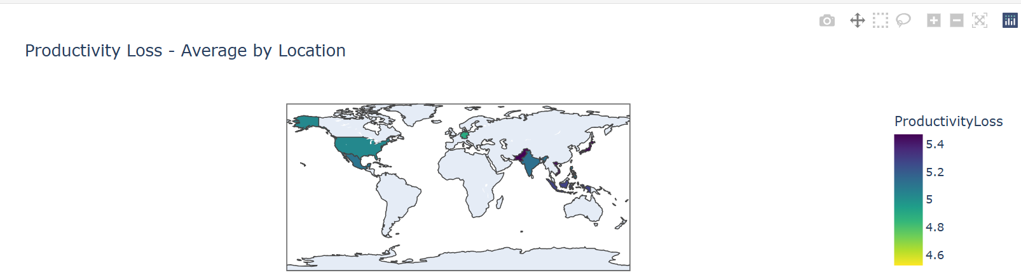

Slide 30
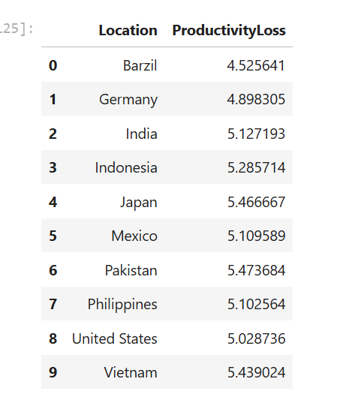
Insights
*Germany has the highest productivity loss.
*Brazil has the lowest productivity loss.

Slide 31
RECOMMENDATIONS TO REDUCE SOCIAL MEDIA'S IMPACT ON PRODUCTIVITY
*Set Time Limits: Use apps or timers to limit how long you spend on social media.
*Turn Off Notifications: Disable social media alerts to avoid distractions.
*Create Social Media-Free Spaces: Keep social media out of your workspace.
*Use Focus Modes: Activate "Focus Mode" on your phone to block distractions.
*Limit Access: Remove social media apps from your phone or use them only on one device.
*Schedule Breaks: Set specific times to check social media, like during lunch or after work.
*Do Other Activities: Replace scrolling with activities like walking, reading, or hobbies.
*Be Mindful: Think about why you're using social media and track your usage.
*Separate Work and Personal Use: Use social media only for work-related tasks during work hours.
*Take Breaks from Social Media: Try digital detoxes by avoiding social media for certain periods, like weekends.
*These can help you stay focused and productive.

Slide 32
- AASTHA GUPTA KESHARWANI DA/DS
THANK YOU

